Slide 1
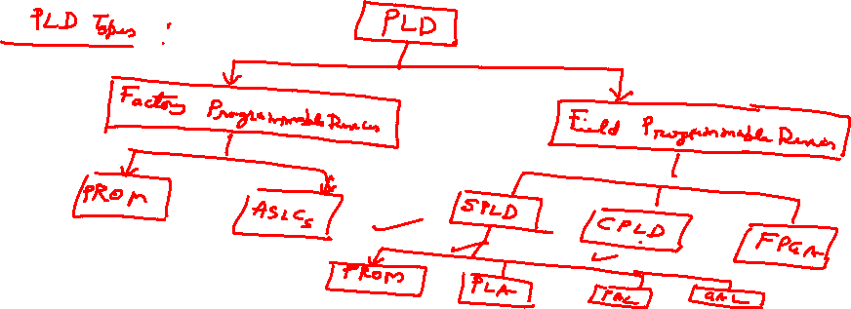
Programming SPLDs
  PLAs, PALs, and ROMs are also called SPLDs – Simple Programmable Logic Devices
  SPLDs must be programmed so that the switches are in the correct places
    CAD tools are usually used to do this

Slide 2
Structure of a CPLD
I/O block
PAL-like
PAL-like
block
block
I/O block
Interconnection wires
I/O block
PAL-like
PAL-like
block
block
I/O block

Slide 3
CPLD
  Complex Programmable Logic Devices (CPLD)
  SPLDs (PLA, PAL) are limited in size due to the small number of input and output pins and the limited number of product terms
    Combined number of inputs + outputs < 32 or so
  CPLDs contain multiple circuit blocks on a single chip
    Each block is like a PAL: PAL-like block
    Connections are provided between PAL-like blocks via an interconnection network that is programmable
    Each block is connected to an I/O block as well

Slide 4
Internal Structure of a PAL-like Block
  Includes macrocells
    Usually about 16 each
  Fixed OR planes
    OR gates have fan-in
    between 5-20
  XOR gates provide
  negation ability
    XOR has a control
    input
PAL-like block
PAL-like block
D
Q
D
Q
D
Q

Slide 5
More on PAL-like Blocks
  CPLD pins are provided to control XOR, MUX, and tri-state gates
  When tri-state gate is disabled, the corresponding output pin can be used as an input pin
    The associated PAL-like block is then useless
  The AND plane and interconnection network are programmable
  Commercial CPLDs have between 2-100 PAL-like blocks

Slide 6
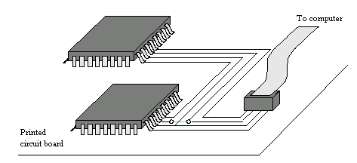
Programming a CPLD
  CPLDs have many pins – large ones have > 200
    Removal of CPLD from a PCB is difficult without breaking the pins
    Use ISP (in system programming) to program the CPLD
    JTAG (Joint Test Action Group) port used to connect the CPLD to a computer

Slide 7
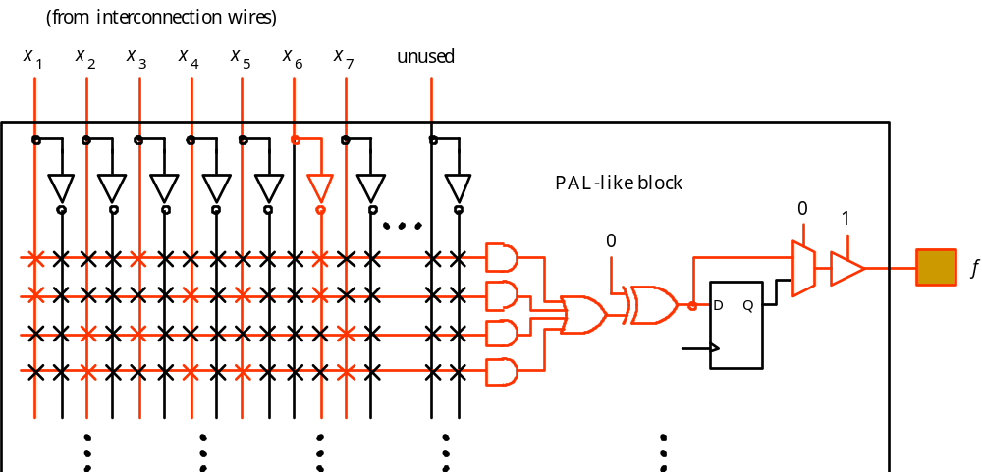
Example CPLD
  Use a CPLD to implement the function
    f = x₁x₃x₆' + x₁x₄x₅x₆' + x₂x₃x₇ + x₂x₄x₅x₇

Slide 8
FPGA
  SPLDs and CPLDs are relatively small and useful for simple logic devices
    Up to about 20000 gates
  Field Programmable Gate Arrays (FPGA) can handle larger circuits
    No AND/OR planes
    Provide logic blocks, I/O blocks, and interconnection wires and switches
    Logic blocks provide functionality
    Interconnection switches allow logic blocks to be connected to each other and to the I/O pins

Slide 9
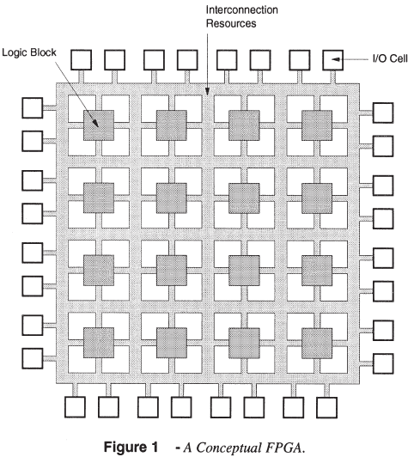
Field-Programmable Gate Arrays

Slide 10
Field-Programmable Gate Arrays
Logic blocks
  to implement combinational
  and sequential logic
Interconnect
  wires to connect inputs and
  outputs to logic blocks
I/O blocks
  special logic blocks at periphery
  of device for external connections
Fig. 1 FPGA Architecture

Slide 11
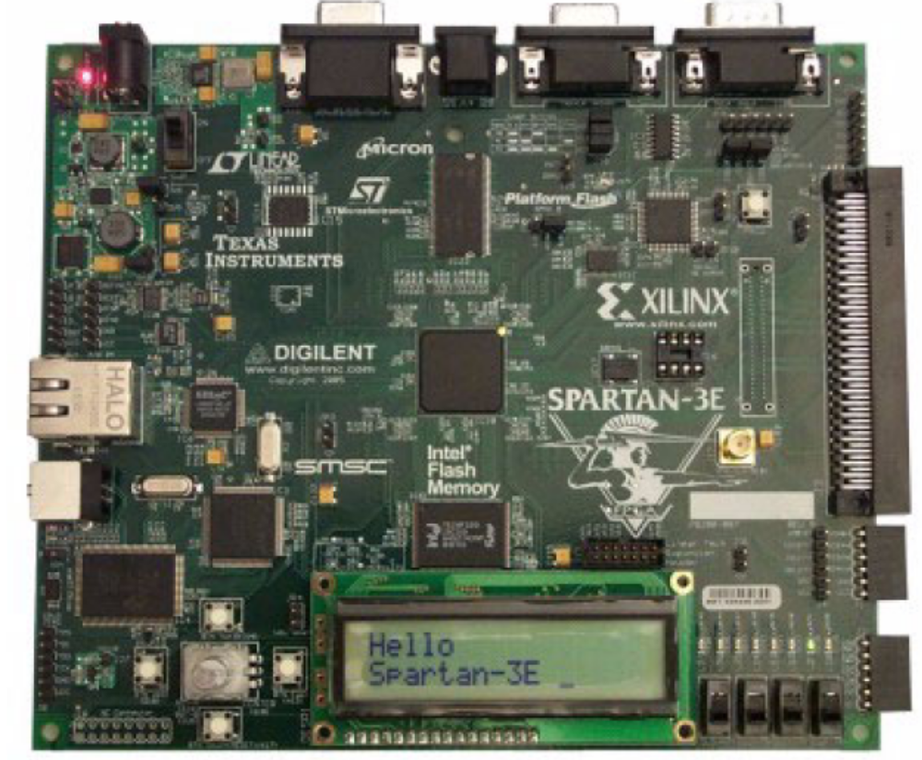
Xilinx Spartan-3E Starter Kit
FPGA

Slide 12
FPGA Principles
A Field-Programmable Gate Array (FPGA) is an integrated circuit that can be configured by the user to emulate any digital circuit as long as there are enough resources
An FPGA can be seen as an array of Configurable Logic Blocks (CLBs) connected through programmable interconnect (Switch Boxes)

Slide 13
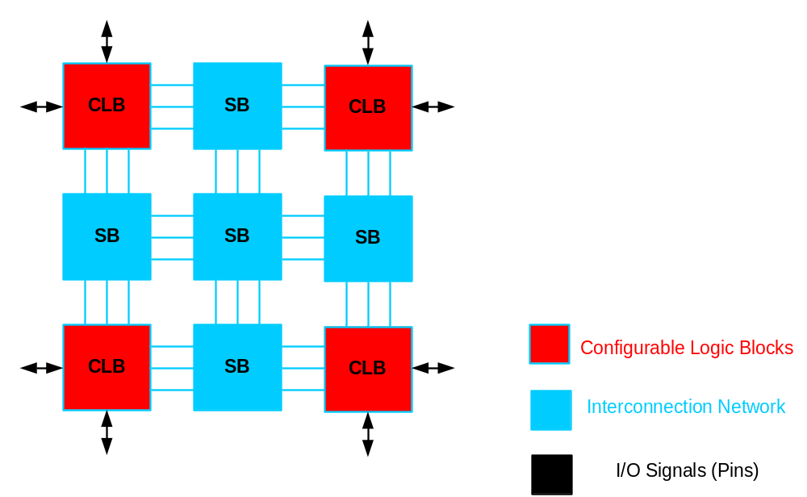
FPGA structure

Slide 14
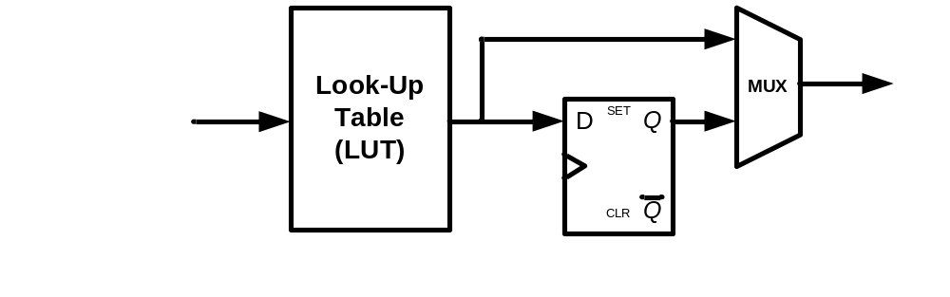

Simplified CLB Structure

Slide 15
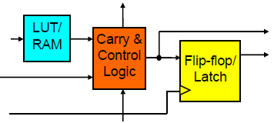
Configurable Logic Blocks (CLBs) Architecture
CLBs consist of:
  Look-up Tables (LUT) which implement the entries of a logic functions truth table
    Some FPGAs can use LUTs to implement small Random Access Memory (RAM)
  Carry and Control Logic
    Implements fast arithmetic operations (adders/ subtractor)
    Can be also configured for additional operations (Built-in-Self Test iterative-OR chain)
  Memory Elements
    Configurable Flip Flops (FFs)/ Latches( Programmable clock edges, set/reset, and clock enable)
    These memory elements usually can be configured as shift-registers

Slide 16
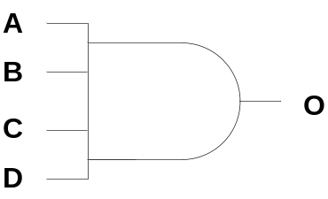
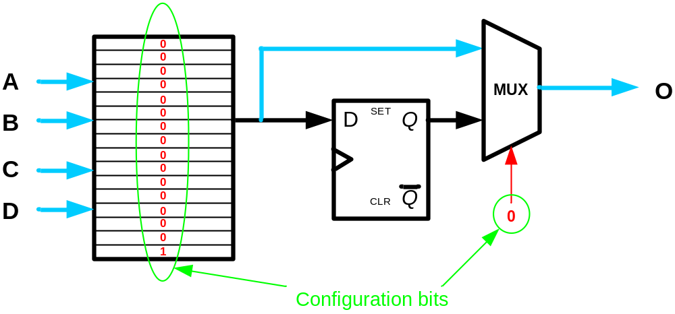
Example: 4-input AND gate
A | B | C | D | O
0 | 0 | 0 | 0 | 0
0 | 0 | 0 | 1 | 0
0 | 0 | 1 | 0 | 0
0 | 0 | 1 | 1 | 0
0 | 1 | 0 | 0 | 0
0 | 1 | 0 | 1 | 0
0 | 1 | 1 | 0 | 0
0 | 1 | 1 | 1 | 0
1 | 0 | 0 | 0 | 0
1 | 0 | 0 | 1 | 0
1 | 0 | 1 | 0 | 0
1 | 0 | 1 | 1 | 0
1 | 1 | 0 | 0 | 0
1 | 1 | 0 | 1 | 0
1 | 1 | 1 | 0 | 0
1 | 1 | 1 | 1 | 1

Slide 17

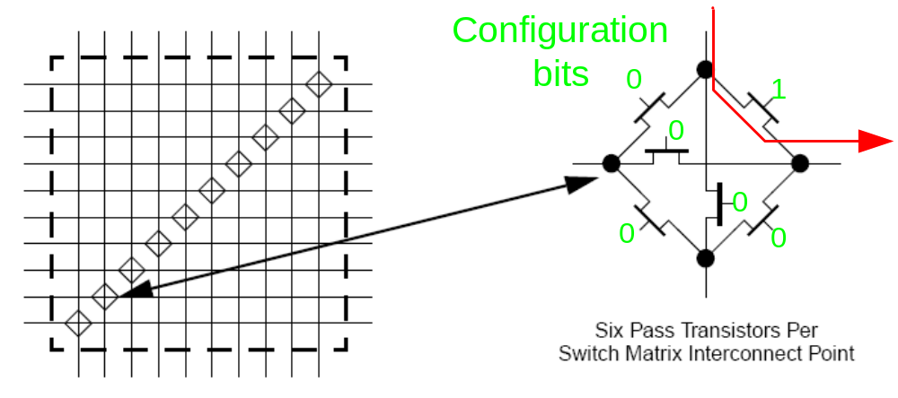
Interconnection Network

Slide 18
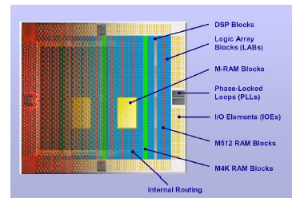
Components of Modern FPGAs

Slide 19
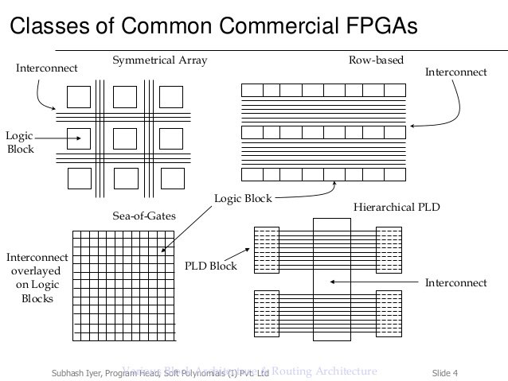

Slide 20
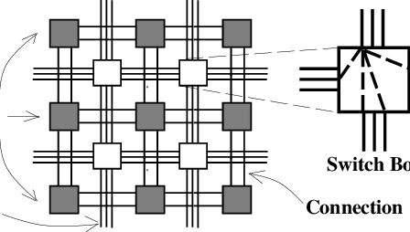
Matrix- based (Symmetrical Array) Architectures

Slide 21
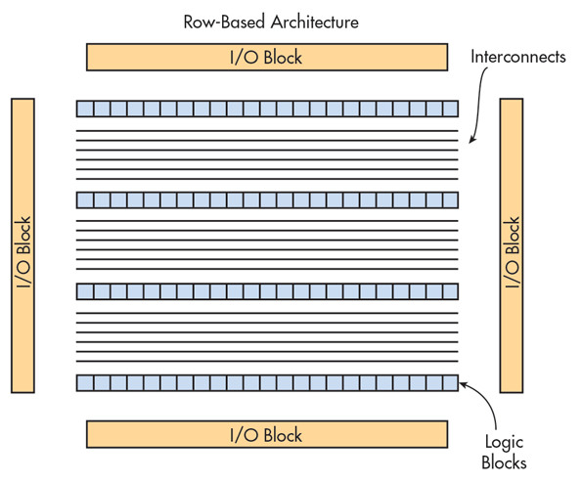
Row- based Architectures

Slide 22
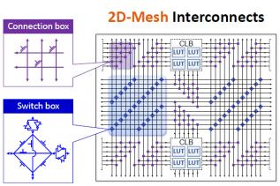
Hierarchical Architectures

Slide 23
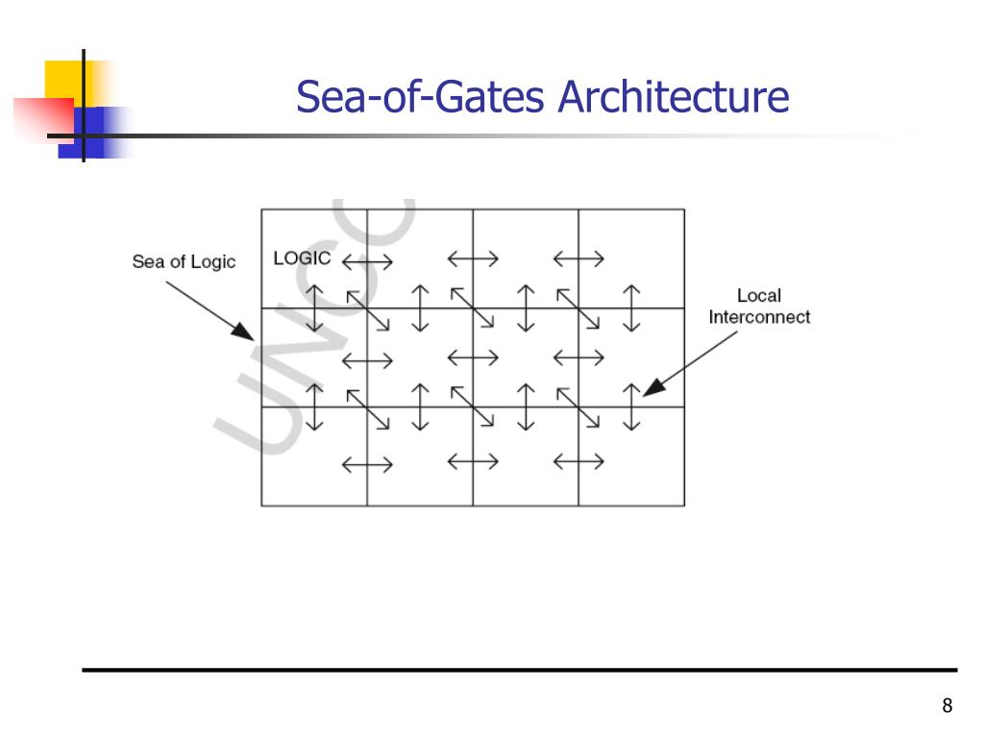

Slide 24
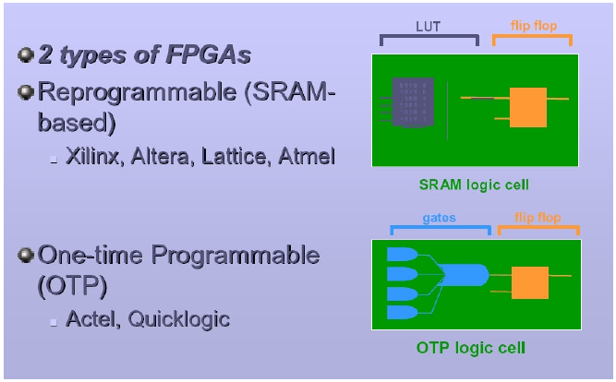
FPGA Programing Technologies
(Anti-fuse technology)

Slide 25
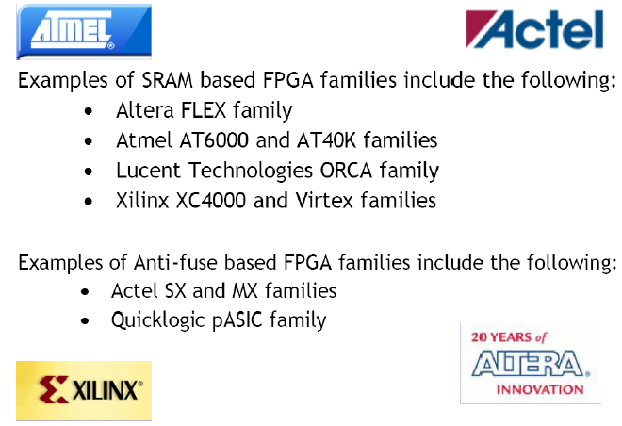
FPGA Families

Slide 26
Custom Chips
  PLDs are limited by number of programmable switches
    Consume space
    Reduce speed
  Custom chips are created from scratch
    Expensive → used when high speed is required, volume sales are expected, and chip size is small but with high density of gates
    ASICs (Application Specific Integrated Circuits) are custom chips that use a standard cell layout to reduce design costs

Slide 27
Digital Logic Technology Tradeoffs
Full custom
VLSI design
ASICs
Speed / Density / Complexity / Likely
Market Volume
CPLDs
FPGAs
PLDs
Engineering cost / Time to develop

